Slide 1
Assignment 6

Slide 2
What Is Artificial Intelligence?
Intelligence built in a computer is artificial intelligence.
Some Branches Of Artificial Intelligence :
Machine Learning
Neural Networks
Robotics

Slide 3
What Is Machine Learning ?
Making the machine learn is known as machine learning.
There are three types of machine learning :
Supervised learning
Un-Supervised learning
Reinforced learning

Slide 4
Types Of Learning
Supervised Learning – Means learn from someone. The Machine is
trained by a person/program
Inputs are known as features
Outputs are known as labels
Function created from input,output data is known as model
Models are created by machine algorithms which needs features and labels,these models predict results.

Slide 5
Types Of Learning
Unsupervised learning : Unsupervised learning is a way where the machine learns on its own.
Reinforced learning : Reinforced learning is earning on a reward,punishment basis

Slide 6
Types of Analytics
Predictive Analytics – Machine Learning comes under Predictive Analysis. Using the past data, we predict the future outcome in Machine Learning.
Prescriptive Analytics
Descriptive Analytics
Diagnostic Analytics

Slide 7
Conventional Programming VS Machine Learning
In conventional programming, we write the program/code which has the equation. We give input to our program and get the output from the program.
In Machine Learning, we give both input and output data to the program, in turn we get the equation/relation between the input and output, which can be used to predict the output in future using the input data provided.

Slide 8
Machine Learning Algorithms
Machine Learning Algorithms are the programs which take the Features and Labels data and give us the relation/equation between the Features and Labels.
There are mainly two types of Machine Learning Algorithms, they are:
Regression Algorithms
Classifier Algorithms
Regression Algorithms are used when the data is continuous, i.e., for continuous-data prediction.
Classifier Algorithms are used to take decisions(based on Boolean Values-True or False, 1 or 0, etc)

Slide 9
Algorithms
Classification Algorithm
Regression Algorithm
Linear Regression
Logistic regression
Decision Tree
SVM(Support Vector Machine)
K-nearest neighbor
Naive Bayes system

Slide 10
Linear Regression Explanation
Regression Algorithm – Linear Regression – Linear Regression is used when the features and labels are linearly related.
Eg: x : 1 2 3 4 5 6
y : 4 7 10 13 16 19
In this example, we see that y is related to x by the equation y=3x+1, indicating the linearity of the relation.
Regression Algorithm can be used for any data where inputs and outputs are related by the function y=mx+c, where power of x always is 1

Slide 11
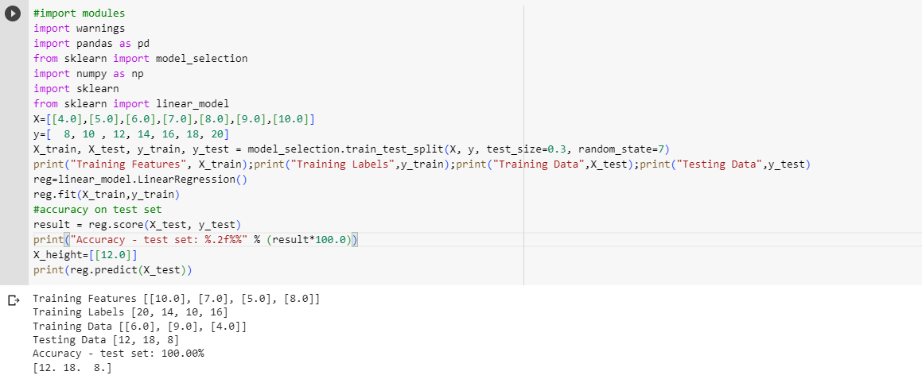
Linear Regression Code

Slide 12
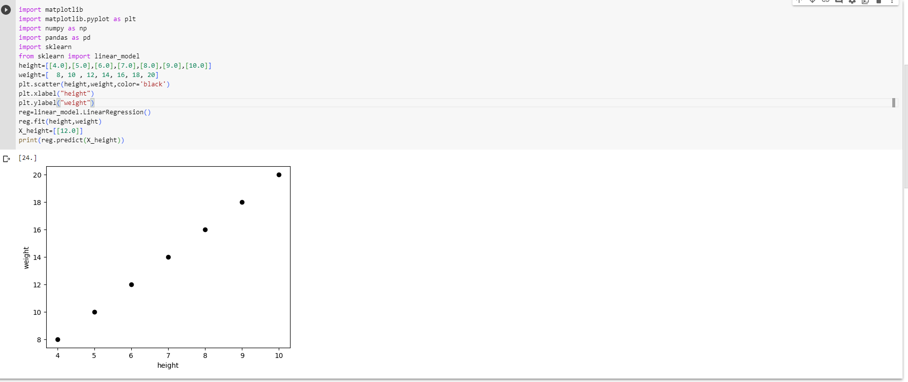
Linear Regression Code

Slide 13
Classification Algorithm
Classification Algorithm – Classification Algorithms are used whenever there is a need to take a decision based on input values.
Eg: Marks : 20 30 35 40 60 80
Pass/Fail : F F P P P P
In this example, we see that the Student will be declared Pass if he scores 35 or above marks, and will be declared Fail if he scores less than 35
Classifier Algorithms can be used whenever there is a need to take a decision based on the input(features) values

Slide 14
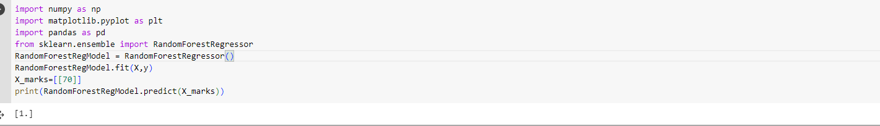
Random Forest Example

Slide 15
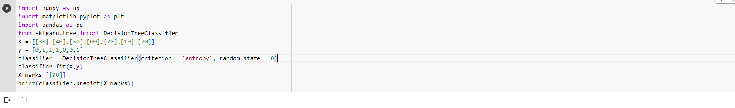
Decision Tree Example

Slide 16
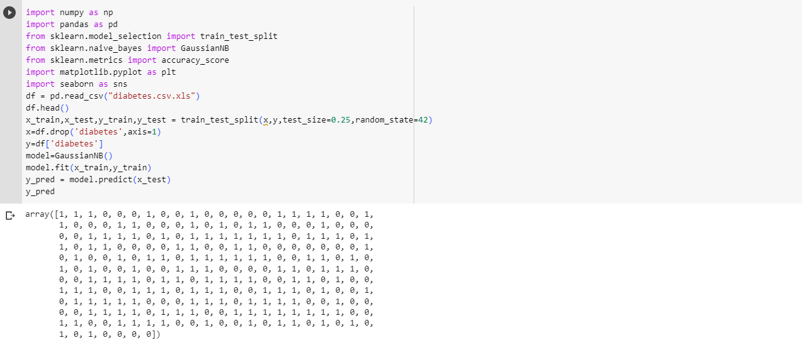
Naive Bayes Example

Slide 17
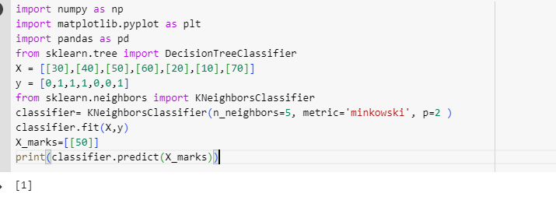
KNN example

Slide 18
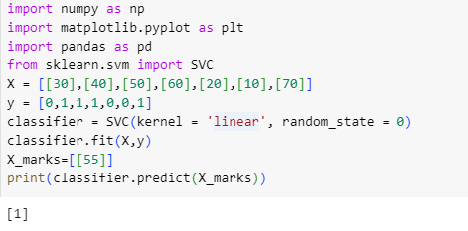
SVM example

Slide 19
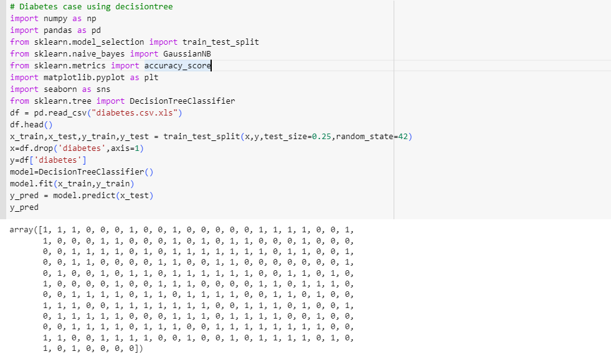
Diabetes Using Decision Tree Algorithm

